Slide 1
Introduction to mathematical optimization

Slide 2
Agenda
Parts of an optimization problem
Objective function examples
Decision variables examples
Constraints and bounds examples
Modeling an optimization problem
Different types of optimization problem
Linear programming
Nonlinear programming
Mixed-integer linear programming
Mixed-integer nonlinear programming
Different solvers for optimization problem
Summary

Slide 3
Parts of an optimization problem
Objective function
The value we are trying to optimize
to be minimized or maximized → optimized
uses some parameters defined in the problem statement
Decision variables
The values the optimizer can change
Also called design or manipulated variables
Constraints and bounds
certain conditions, and limitations enforced on the solutions
uses some parameters defined in the problem statement

Slide 4
Objective function examples
Minimize operating cost
Minimize waste
Minimize greenhouse gas emissions
Maximize profit
Maximize yield
Any combination of above (e.g. minimize waste and maximize profit)

Slide 5
Decision variable examples
Tank volume
Temperature and pressure of a reactor
Sales price
Number of staff at different hours of the day
Detailed schedules
units of a product shipped to different destinations
Size of pasture land

Slide 6
Constraints and bounds examples
Availability of staff
Budget for a given project
Environmental regulation
Availability of raw material
Supply
Demand
Farm size

Slide 7


Modeling an optimization problem
Mathematical optimization is an art to convert a business problem to a mathematical representation and then solve it.
That is the whole idea of this course too!
$$\min{f(x)}$$
subject to
$$h\left(x\right)=0$$
$$g\left(x\right)≤0$$
$$x∈R^{n}$$

Slide 8


Different types of optimization problem
Linear programming (LP)
f, h, and g are all linear
x is all continuous variable
Nonlinear programming (NLP)
f, h, or g is nonlinear
x is all continuous variable
Mixed-integer linear programming (MILP or MIP)
f, h, and g are all linear
x has at least one integer variable
Mixed-integer nonlinear programming (MINLP)
f, h, or g is nonlinear
x has at least one integer variable
$$\min{f(x)}$$
subject to
$$h\left(x\right)=0$$
$$g\left(x\right)≤0$$
$$x∈R^{n}$$

Slide 9


Different types of optimization problem (especial case)
A quadratic terms are
A non-quadratic but still nonlinear terms are
If f, h, or g has quadratic nonlinear term(s), then it will be a special case:
The special case for NLP is Quadratically Constrained Program (QCP)
The special case for MINLP is Mixed Integer Quadratically Constrained Program (MIQCP)
$x_{1}x_{1}$ , $x_{1}$ $x_{2}$
$x_{1}x_{2}^{2}$ , $x_{1}^{0.5}$, $e^{x_{1}}$

Slide 10
Different solvers for optimization problem
Free license versus commercial license
Demo license
Global solver versus local solver
Initial guess 1
Initial guess 2

Slide 11
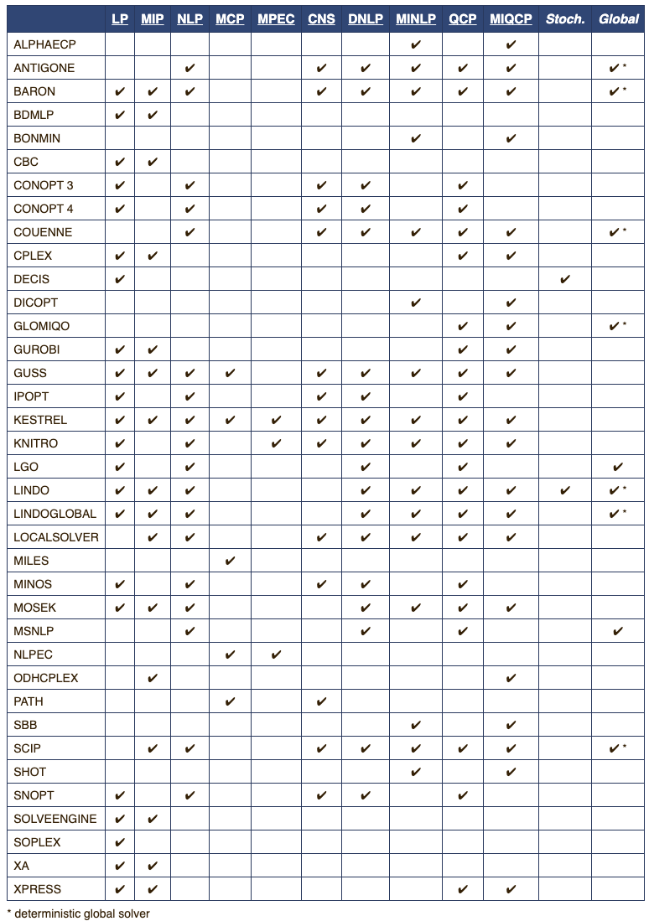
Different solvers for optimization problem
These are only available solvers on GAMS
We only covered the main optimization problems
Global solvers are identified in the last column
When you know the type of your optimization problem, you can find the right solver for it.
https://www.gams.com/latest/docs/S_MAIN.html

Slide 12
Different solvers for optimization problem
MINLP
MILP
NLP
LP
QCP
MIQCP

Slide 13
Summary
Parts of an optimization problem (Objective function, Decision variables, Constraints)
Modeling an optimization problem
Different types of optimization problem (Linear programming, Nonlinear programming, Mixed-integer linear programming, Mixed-integer nonlinear programming)
Different solvers for optimization problem

